Slide 1
WELCOME TO
HANDS-ON MATHS

Slide 2
Let’s Try On Some Hands-On Activity

Slide 3

Please check if everybody has:
  3 Rectangular Paper Piece

Slide 4
Lets Find
a^{m}
Using
PAPER FOLDING ACTIVITY

Slide 5
Exponents/Index/Power
a^{m}
Base

Slide 6
Take one piece of paper.
Each piece represents the base 2.
Fold it once into two equal parts lengthwise.

Slide 7
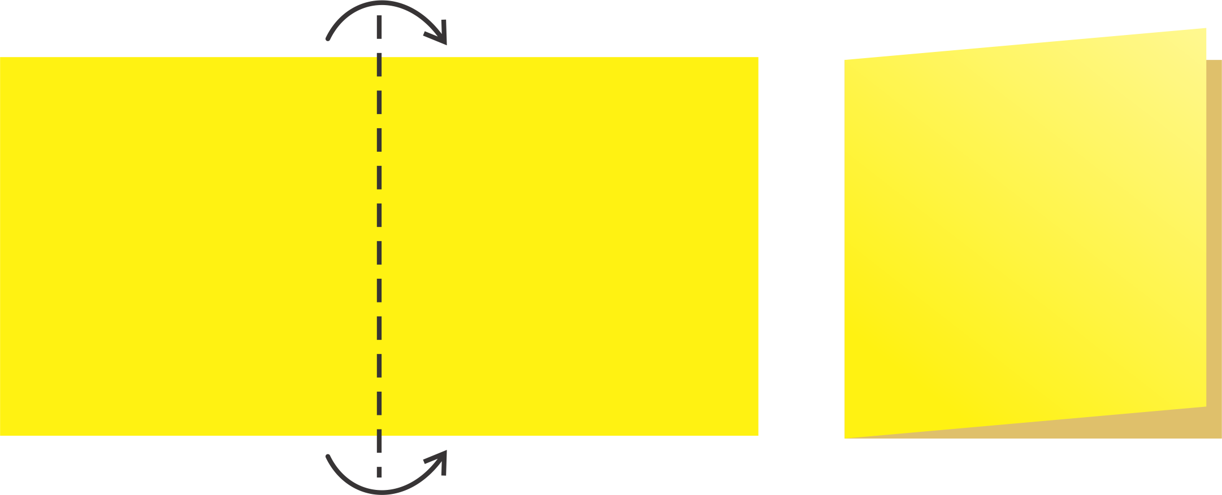
Fold lengthwise
Result

Slide 8
How many times have you folded?

Slide 9
ONE TIME

Slide 10
Unfold the paper and observe.
How many equal parts have you got?

Slide 11

Two Parts
1
2

Slide 12
∴2¹=2
2
is Base Number
¹
is Power (fold)

Slide 13
Take second piece of paper.
Fold it into two equal parts lengthwise and then breadthwise.

Slide 14
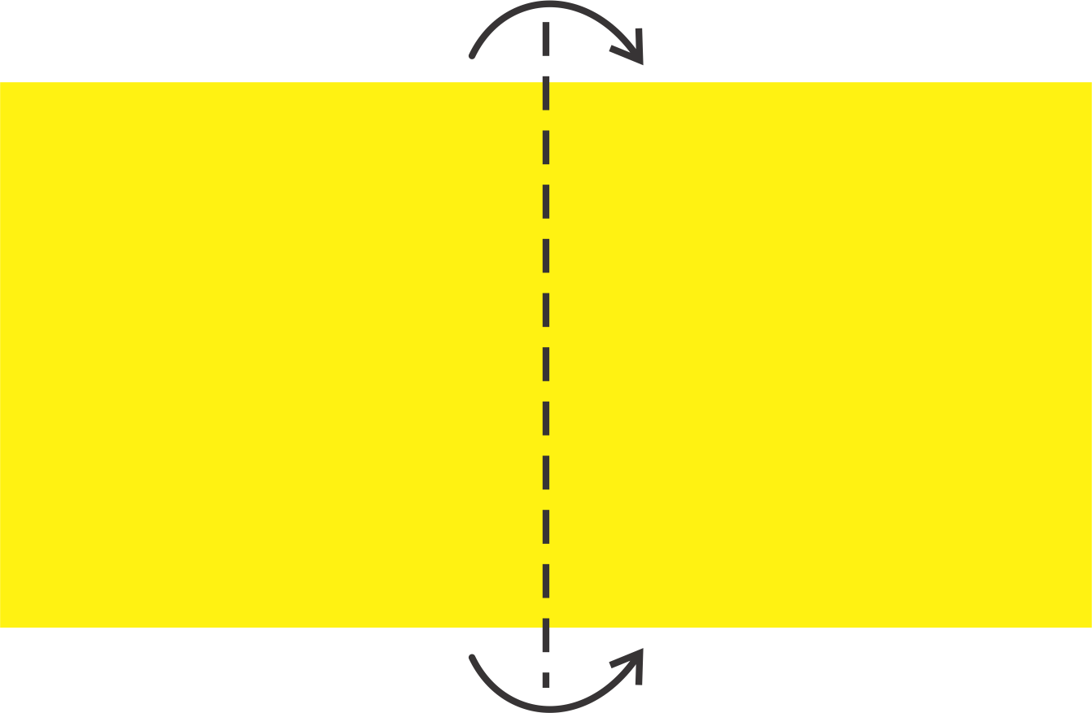
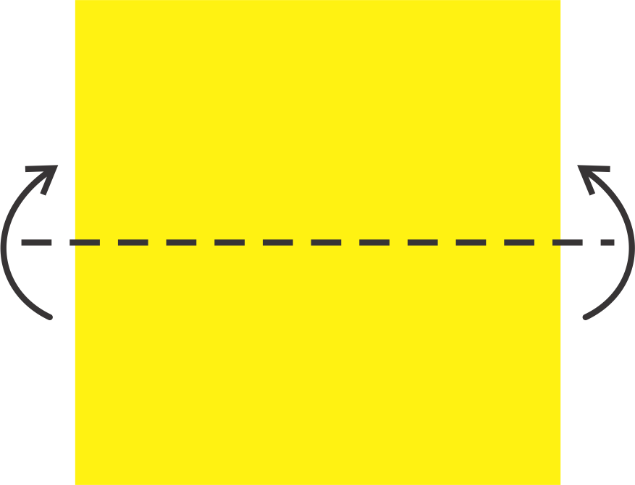

Fold lengthwise
Fold breadthwise
Result

Slide 15
How many times have you folded?

Slide 16
TWO TIMES

Slide 17
Unfold the paper and observe.
How many equal parts have you got?

Slide 18

Four Parts
1
2
3
4

Slide 19
∴2²=4
2
is Base Number
²
is Power (fold)

Slide 20
Take the third piece of paper.
Fold it into two equal parts,
first lengthwise, then breadthwise and then again lengthwise.

Slide 21
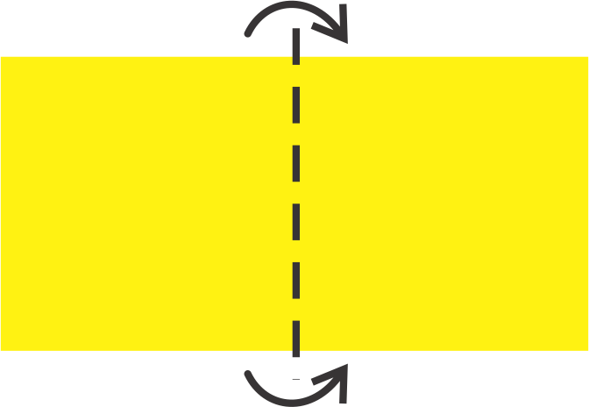

Fold lengthwise
Fold breadthwise
Fold lengthwise
Result

Slide 22
How many times have you folded?

Slide 23
THREE TIMES

Slide 24
Unfold the paper and observe.
How many equal parts have you got?

Slide 25

Eight Parts
1
2
3
4
5
6
7
8

Slide 26
∴2³=8
2
is Base Number
³
is Power (fold)

Slide 27
What do we do to find the powers of
^{n}
?
3

Slide 28
For finding
3^{n}
you have to fold
into 3 equal parts

Slide 29
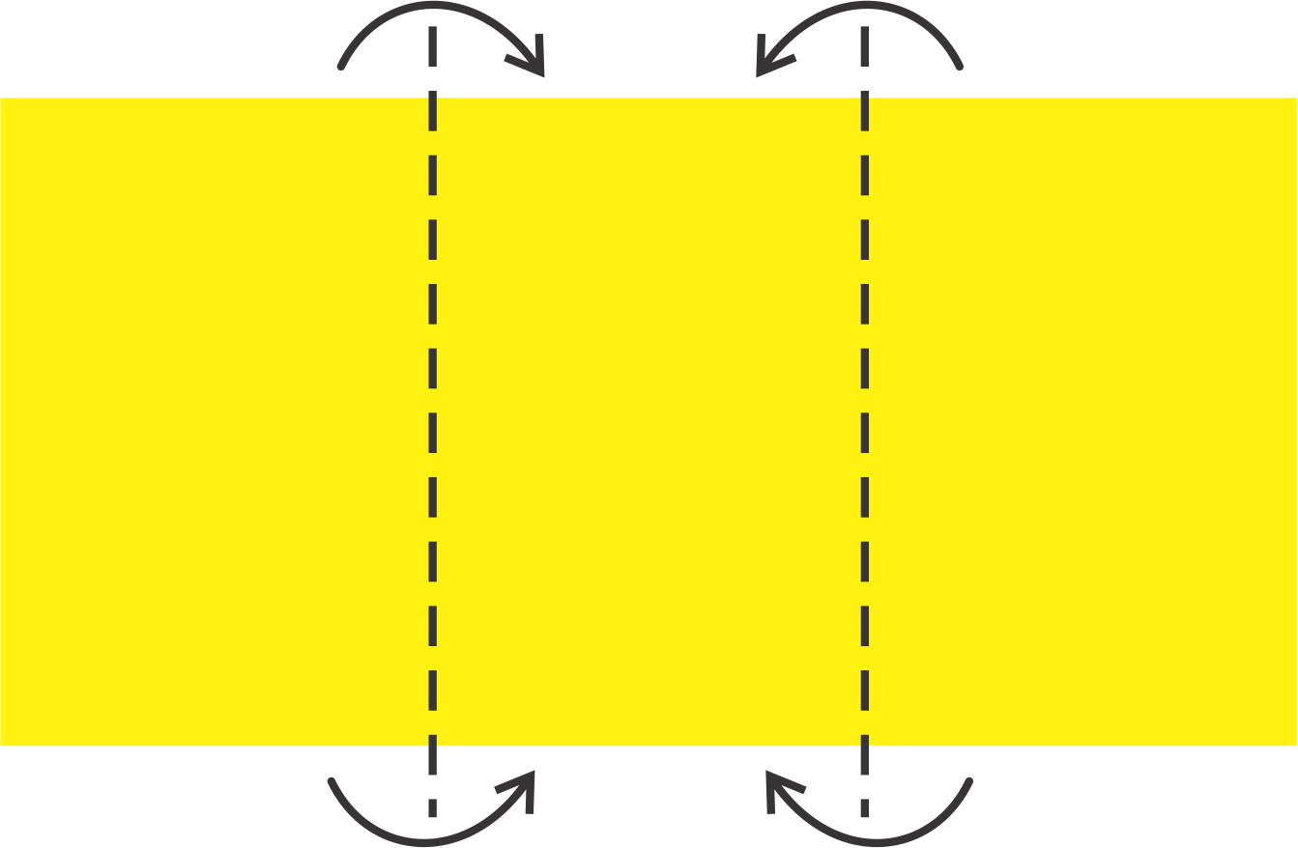


3¹
Result
Fold lengthwise
1
2
3
Unfolded

Slide 30
∴3¹=3
3
is Base Number
¹
is Power (fold)

Slide 31
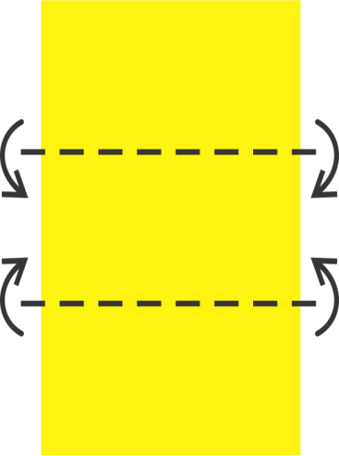


3²
Result
Fold lengthwise
Fold breadthwise
1
2
3
4
5
6
7
8
9
Unfolded

Slide 32
∴3²=9
3
is Base Number
²
is Power (fold)

Slide 33
What are the Numbers of the type
a^{m}
called?

Slide 34
Numbers of the type
a^{m}
are called

Slide 35
EXPONENTS

Slide 36
  Thank you
  Very Much !

